Slide 1

Phoenix LiveView & PubSub
FOR REAL TIME AND SCALABLE WEB APP
Saigon Elixir - Athena Studio
(by Ohhi.vn team)

Slide 2
Agenda
LiveView
Introduce about LiveView.
Concept of LiveView.
Events of LiveView.
PubSub
Introduce about PubSub.
Use cases.
Demo
Use LiveView & PubSub for simple web app.
Q&A

Slide 3
About team & me
Ohhi.vn team
Started in 2022, first project from 2023.
Target about Elixir/Erlang ecosystem & try to make new things.
Team has contributed 2 open source projects.
Me (Manh Vu)
Former core team (Antivirus product) of CMC CyberSecurity. Author of CMC CryptoSHIELD (a ransomware protector).
Former Sr. Erlang developer (& training Erlang for new members) of DEK.
Developing high performance rule based detection engine & network graph engine (by Golang) for new SOC (Security Operations Center).

Slide 4
LiveView - Introduce
Stateful (on one process), for easy develop.
Difference with regular Phoenix page(MVC).
Server-rendered HTML.
Fault tolerance already (yes, we can sleep well).

Slide 5
LiveView - Concept
LiveView (in server side) is a process.
Handle event from client or other process.
Calculate difference data for updating.
Send update diff HTML to client.
Client use JS:
Load full HTML page then execute JS.
Update DOM received diff HTML from server.
Push events to server.

Slide 6
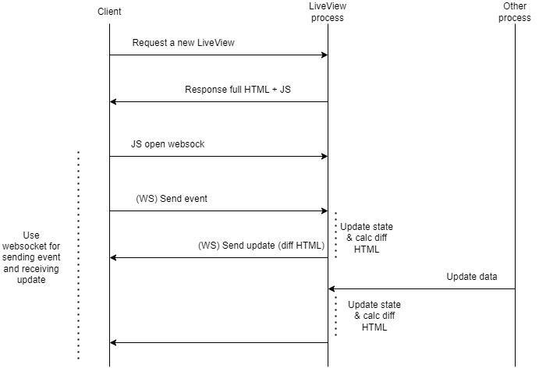

Slide 7
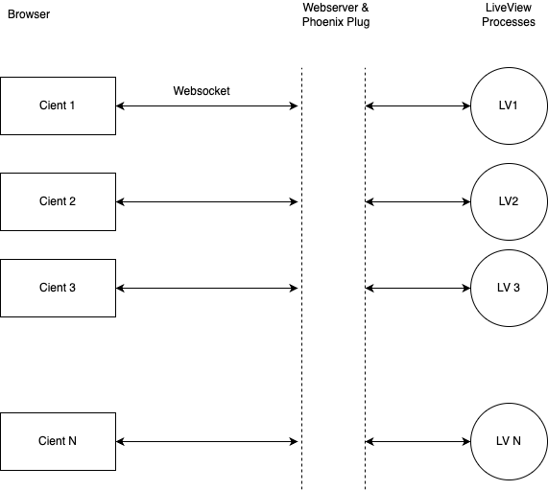

Slide 8
LiveView - Events
Three main callbacks for handle events:
1. mount event for init state & verify/authen (if don’t use plug).
2. render event for render html (render first full html page, then calculate diff html for updating).
3. handle_event handle events from client.
Opts:
handle_info (handle msg from other/self).
terminate for clean up/save state.
Others: handle_async, handle_cast, handle_call.

Slide 9
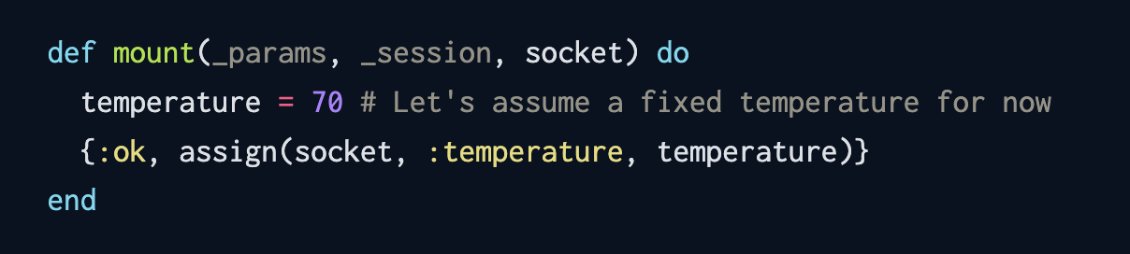
LiveView - Events - mount
Where to init first state (or load saved state),
Handle query params, session.

Slide 10
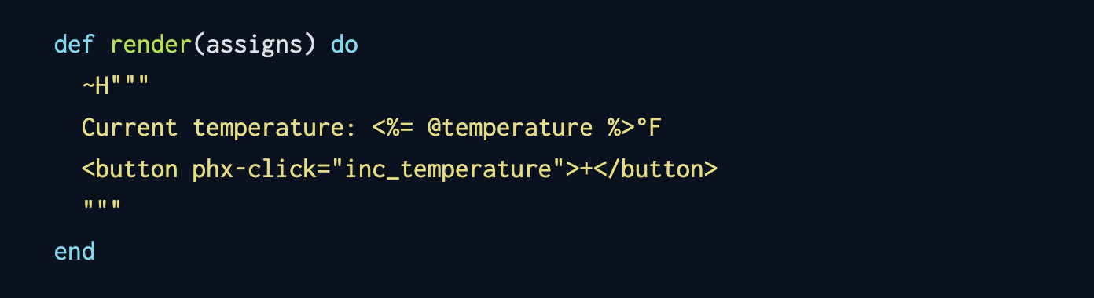
LiveView - Events - render
Render full HTML page for the first time.
Render diff HTML for next time.
Client use morphdom lib for update DOM.
Uses EEx engine to evaluate code in inside string.

Slide 11
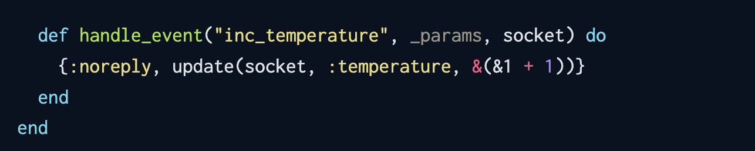
LiveView - Events - handle_event
Handle events from client.
Update state for LiveView process.
After new value was set to socket LiveView will check different and push update to client.

Slide 12
LiveView - Some docs
Getting Started with Phoenix LiveView
The Lifecycle of a Phoenix LiveView
How EEx Turns Your Template Into HTML | Mitchell Hanberg
Phoenix LiveView JavaScript Hooks and Select2

Slide 13
PubSub - Introduce
A message broker for process.
A Phoenix library, can use for any Elixir app.
Use for send messages between processes on local (a node) or across a cluster (many nodes).
Don’t like send message between processes, PubSub don’t need to know who will receive (yes, reduce complexity on develop).
Scalable for small or medium service.
We can use third party dispatcher or self develop.

Slide 14
PubSub - How to use
Add deps (mix.exs) & a supervisor (ex: Application’s supervisor):
{:phoenix_pubsub, "~> 2.1"}
{Phoenix.PubSub, name: Trading.PubSub}
Subscribe/Unsubscribe a topic:
PubSub.subscribe(:pubsub_name, “topic_name”)
PubSub.unsubscribe(:pubsub_name, “topic_name”)
Broadcast a message:
PubSub.broadcast(:pubsub_name, “topic_name”, {:greeting, “hello”})
Handle event from PubSub:
handle_info({:greeting, content}, state)

Slide 15
PubSub - Docs
Distributed Phoenix Chat with PubSub PG2 adapter
https://threadreaderapp.com/thread/1421126817373507584.html

Slide 16
LiveView & PubSub together
Use PubSub for transporting data between LiveView processes, LiveView and other processes and between nodes.
LiveView process will subscribe/broadcast message from/to PubSub.
Suitable for async & scalable data processing.

Slide 17

Demo - Stock Price Dashboard
Two Elixir apps:
Frontend app uses Phoenix LiveView for dashboard, subscribes Phoenix PubSub for getting changed price from Trading service.
Trading app, a stock price simulator.
Repo: https://github.com/ohhi-vn/live_pub_demo

Slide 18
Simple flow of events in Demo

Slide 19
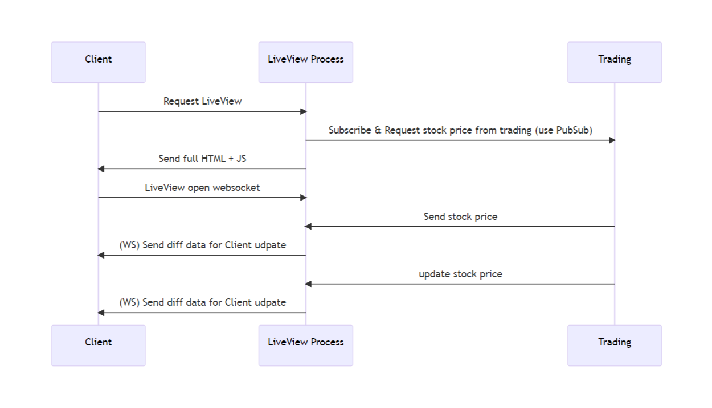

Slide 20
Q & A
Time for Q/A & discussing!

Slide 21
Thank you!
Hope to see you in our next sharing session!
Next topic?
Macro(meta programming) in Elixir & how it works?
Deep dive to Phoenix framework.
Introduce Nx & Axon. An advantage stack (frontend/backend, data analysis, ML/DL).
Build a distributed system with Elixir.
Passwordless authentication & Single Sign On (SSO) solution by WebAuthn & OAuth2 (demo with Elixir).
Or somethings else?

